Slide 1


Lewis Njau
February 10, 2024

Slide 2
Outline
Executive Summary
Introduction
Methodology
Results
Conclusion
Appendix

Slide 3

Executive Summary
Summary of methodologies
Data Collection using SpaceX REST API.
Cleaning the data for analysis
Perform Exploratory data analysis (EDA) using SQL and Python libraries.
Create interactive visual analytics and dashboards.
Build and evaluate ML models (Classification) to predict landing outcomes.
Summary of all results
Increasing success rate of launches over time.
ES-L1, GEO, HEO, and SSO orbits have the highest success rate.
Most launch sites are close to the coastline
All predictive models performed similarly on the test dataset with a score of 83% accuracy.

Slide 4
Introduction
Project background and context
SpaceX advertises Falcon 9 rocket launches on its website, with a cost of 62 million dollars; other providers cost upward of 165 million dollars each, much of the savings is because SpaceX can reuse the first stage. Therefore, if we can determine if the first stage will land, we can determine the cost of a launch. This information can be used if an alternate company wants to bid against SpaceX for a rocket launch.
Problems you want to find answers
Rate of successful landings over time
Explore which factors contribute to a successful landing by utilizing feature engineering.
Determine the best performing ML model in predicting landing success.

Slide 5

Section 1

Slide 6
Methodology
Executive Summary
Data collection methodology:
The data was collected using the SpaceX REST API and through web scraping Falcon 9 and Falcon Heavy records from Wikipedia.
Perform data wrangling
The data was cleaned, split between train and test, and lastly applied hot encoding to prepare data for analysis and modeling.
Perform exploratory data analysis (EDA) using visualization and SQL
Perform interactive visual analytics using Folium and Plotly Dash
Perform predictive analysis using classification models
How to build, tune, and evaluate classification models

Slide 7
Data Collection
Data was collected using the request (get) Python library to extract data from SpaceX REST API. The extracted data was then decoded into a JSON response and normalized.
The data was cleaned, checking for duplicates or missing values. Web scraped Wikipedia for Falcon 9 and Falcon Heavy records using the BeautifulSoup Python library.
The extracted records were parsed and converted into a Pandas data frame for analysis.

Slide 8
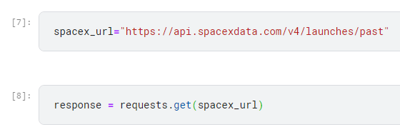
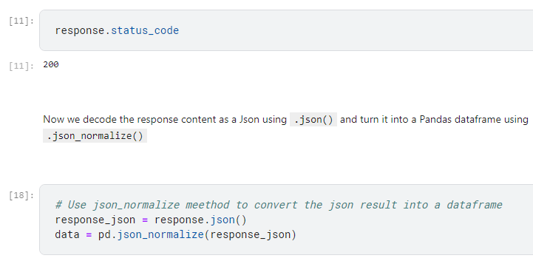
Data Collection – SpaceX API
To extract SpaceX data using their API, I utilized the request (get) Python library. Converted the data into a JSON response and normalized the data for better analysis
Notebook link: https://github.com/LouN99/Applied-Data-Science-Capstone-Project/blob/main/jupyter-labs-spacex-data-collection-api.ipynb

Slide 9
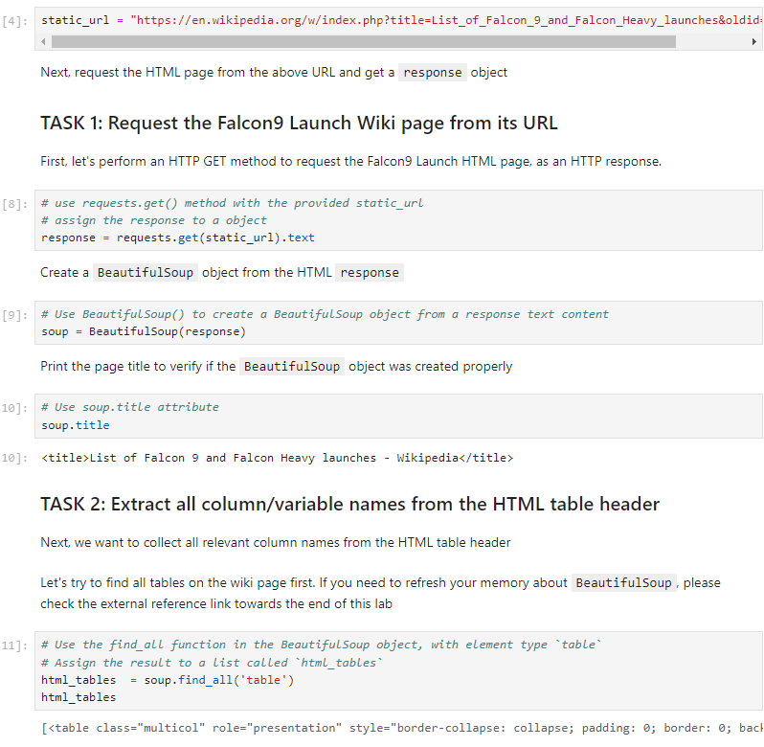
Data Collection - Scraping
Web scraped Falcon 9 records from Wikipedia using the Beautiful Soup Python library. Collected the data from parsing the HTML tables the converted the data into a data frame.
Notebook link: https://github.com/LouN99/Applied-Data-Science-Capstone-Project/blob/main/jupyter-labs-webscraping.ipynb

Slide 10
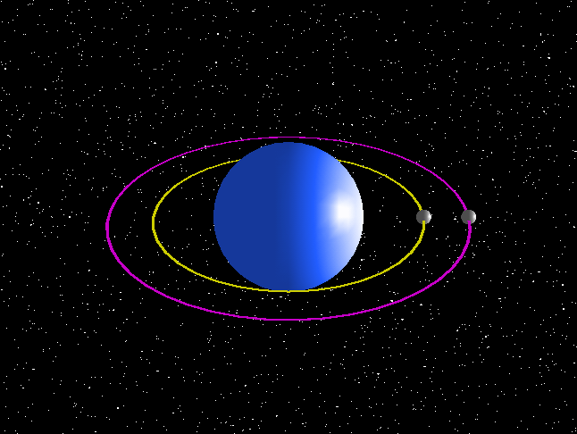
Data Wrangling
Performed Exploratory Data Analysis to determine the number of launches for each site and the occurrence of each orbit to flight number.
The dataset was analyzed to determine training labels for modeling and lastly the results were exported to a CSV file.
Notebook link: https://github.com/LouN99/Applied-Data-Science-Capstone-Project/blob/main/labs-jupyter-spacex-Data%20wrangling.ipynb

Slide 11
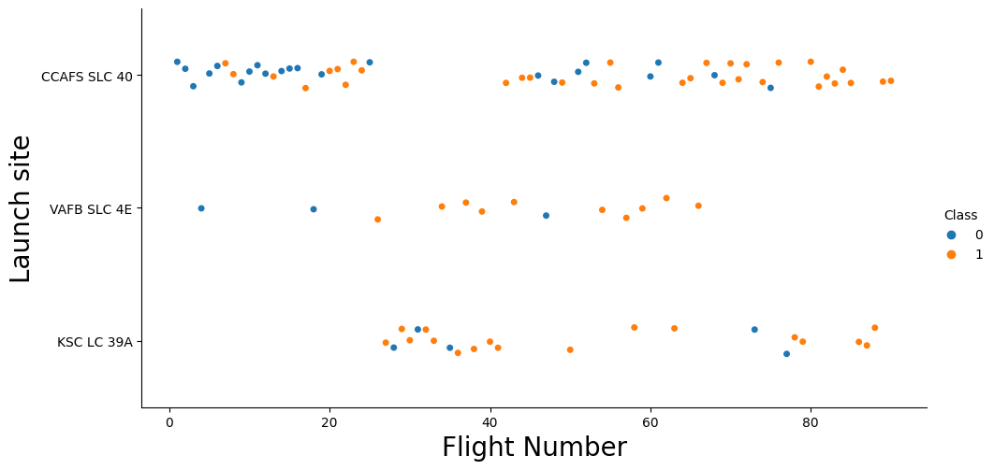
EDA with Data Visualization
Analyzed the data by examining connections between flight numbers and launch sites, payloads and launch sites, the success rates of various orbits, flight numbers, and orbit types, and the annual trend in launch successes.
Charts:
Flight Number vs Payload Mass
Flight Number vs Launch Site
Payload Mass vs Orbit Type
Payload Mass vs Launch Site
Notebook Link:
https://github.com/LouN99/Applied-Data-Science-Capstone-Project/blob/main/jupyter-labs-eda-dataviz-ipynb-jupyterlite.ipynb

Slide 12
EDA with SQL
Through the implementation of Exploratory Data Analysis (EDA) and SQL, I gained valuable insights into the dataset. Specifically, I formulated SQL queries to ascertain various details such as:
Distinct launch sites used in the space mission
Aggregate payload mass of boosters deployed
Mean payload mass for the Falcon 9
Overall counts of mission outcomes, categorized into successes and failures
Details of unsuccessful landings on the drone ship (including booster versions and names of launch sites involved)
Notebook link:
https://github.com/LouN99/Applied-Data-Science-Capstone-Project/blob/main/jupyter-labs-eda-sql-coursera_sqllite.ipynb

Slide 13
Build an Interactive Map with Folium
All launch locations were plotted on the folium map, with various map elements like markers, circles, and lines indicating whether launches at each site were successful or not.
The outcome of each launch, being either a failure or a success, was categorized into two classes: class 0 for a failure and class 1 for a success.
Through the use of clusters of color-coded markers, I pinpointed launch sites with a notably high rate of successful launches. I measured the distance from each launch site to various nearby features and explored several questions, such as whether the launch sites are situated close to railways, highways, or coastlines, and if they maintain a specific distance from urban areas.

Slide 14
Build a Dashboard with Plotly Dash
The dropdown list with launch sites allows users to select filter results for each launch site. The pie chart displays all successful and unsuccessful launches as a percent of the total.
Notebook link:
https://github.com/LouN99/Applied-Data-Science-Capstone-Project/blob/main/Capstone_Project_Dash.py

Slide 15
Predictive Analysis (Classification)
Created a Numpy array from the Class column. I standardized the dataset with the StandardScaler function from the Sklearn Python library and transformed the dataset. Using the ‘train_test_split’ function, I split the data into two sets (train set and test set).
I created and applied the GridSearchCV object on different classification models such as Logistic regression, Support Vector Machine (SVC), Decision tree, and K-Nearest Neighbor.
I calculated the accuracy on the test dataset using the method ‘score’ for all models, and then lastly, I identified the best model using F1_score, Jaccard_Score, and Accuracy.
Notebook link:
https://github.com/LouN99/Applied-Data-Science-Capstone-Project/blob/main/spacex-machine-learning-prediction-part-5-jupyterl.ipynb

Slide 16
Results
Exploratory data analysis results
KSC LC 39A and VAFB SLC 4E have a success rate of 77%
Launch success has improved over time
Orbits ES-L1, GEO, HEO, and SSO have a 100% success rate
Interactive analytics demo in screenshots
All launch sites are close to the coastline
Using the Folium map, launch sites are located far enough from cities, highways, and railways to protect urban infrastructure in the event of a failed launch.
Predictive analysis results
The Decision tree model performed best with a score of 86%
All models performed similarly on the test set with an 83% accuracy score.

Slide 17

Section 2

Slide 18
Flight Number vs. Launch Site
Earlier flights had a lower success rate and were mostly launched at the CCAFS SLC 40 launch site.
VAFB SLC 4E and KSC LC 39A launch sites have a higher success rate

Slide 19
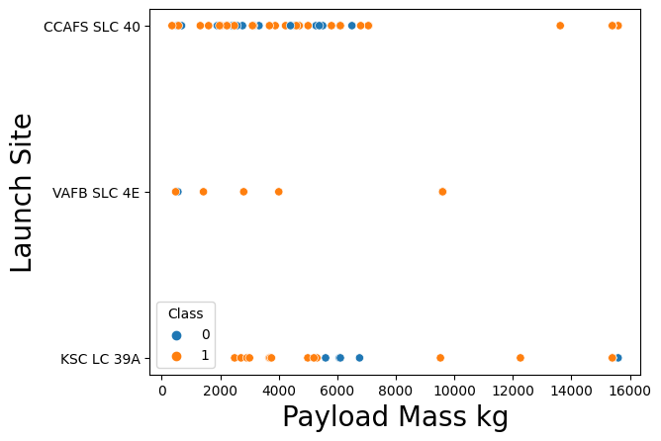
Payload vs. Launch Site
On average, the higher the payload mass, the higher the success rate
There are no rockets launched for payload mass greater than 100,000 kg at the VAFB SLC 4E launch site.

Slide 20
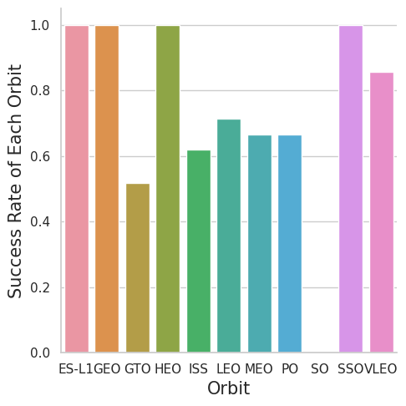
Success Rate vs. Orbit Type
Orbits ES-L1, GEO, HEO, and SSO had a success rate of 100%

Slide 21
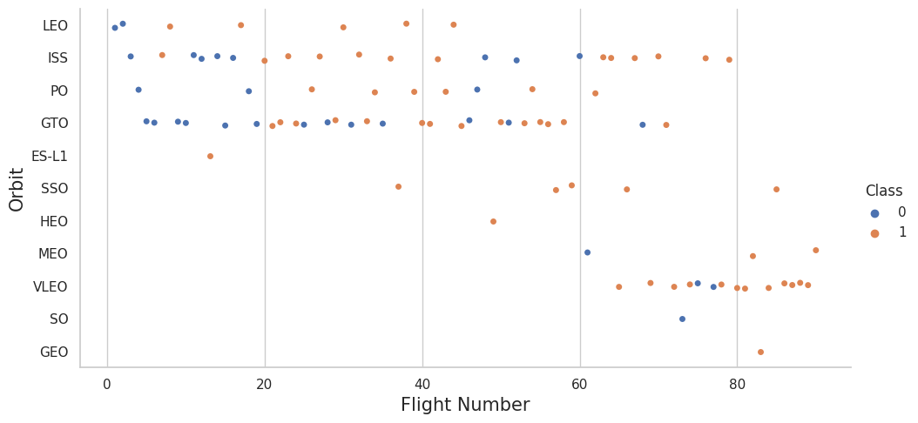
Flight Number vs. Orbit Type
Overtime, the success rate has been increasing with the number of flights for each orbit, which is highly evident for the LEO orbit.

Slide 22
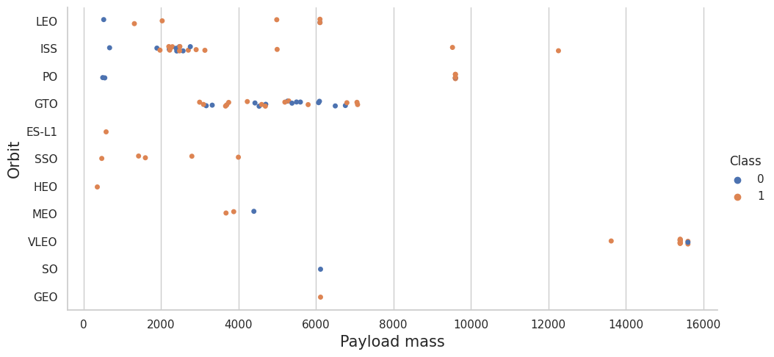
Payload vs. Orbit Type
Heavy payloads are more suitable with LEO, ISS, and PO orbits, while the GTO orbit presents a mixed relationship between payload and orbit type.

Slide 23
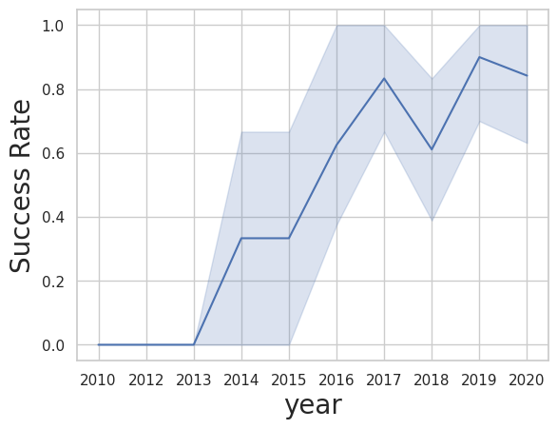
Launch Success Yearly Trend
Overall, the success rate has improved since 2013
The highest decline in success rate is observed to be between 2017-2018

Slide 24
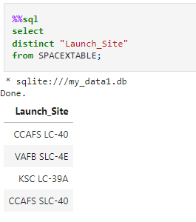
All Launch Site Names
Launch site names:
CCAFS LC-40
VAFB SLC-4E
KSC LC-39A
CCAFS SLC-40

Slide 25
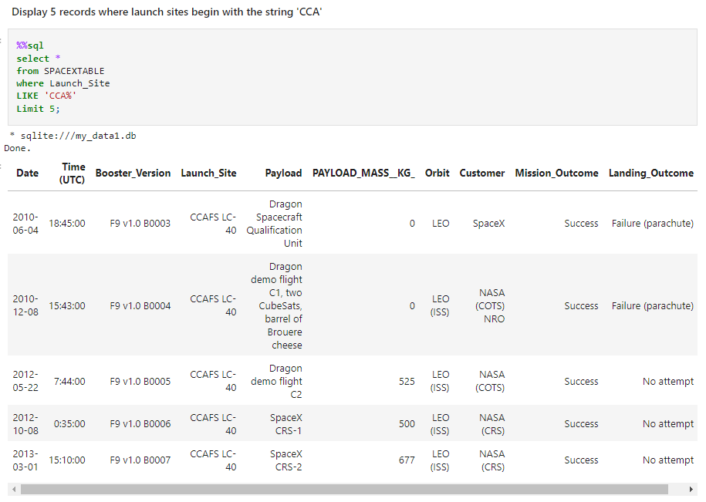
Launch Site Names Begin with 'CCA'
The query displays 5 records where the launch sites begin with ‘CCA’

Slide 26
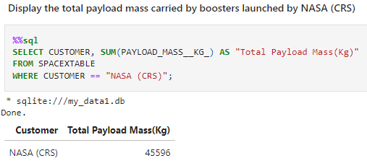
Total Payload Mass
The total payload mass carried by boosters launched by NASA is 45,596 kg

Slide 27
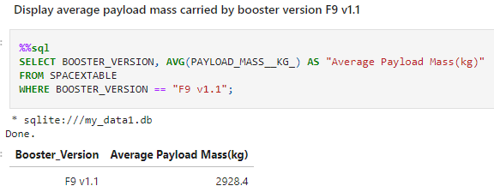
Average Payload Mass by F9 v1.1
The average payload mass carried by booster version F9 v1.1 is 2,928.4 kg

Slide 28
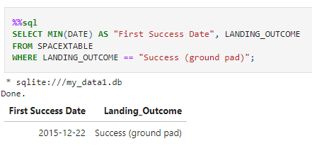
First Successful Ground Landing Date
The first successful ground landing date was on December 22, 2015

Slide 29
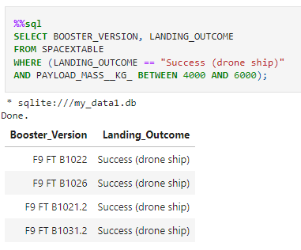
Successful Drone Ship Landing with Payload between 4000 and 6000
The names of the boosters which have success in drone ships and have a payload mass between 4000 kg and 6000 kg are:
F9 FT B1022
F9 FT B1026
F9 FT B1021.2
F9 FT B1031.2

Slide 30
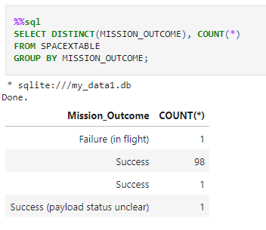
Total Number of Successful and Failure Mission Outcomes
The total number of successful mission outcomes was 100 with one among the 100 with an unclear payload status.
The total number of failure mission outcomes was 1

Slide 31
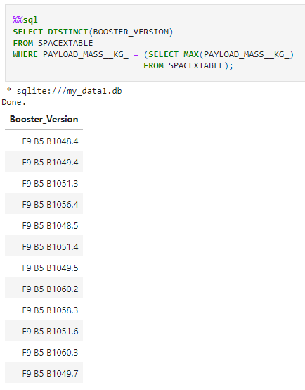
Boosters Carried Maximum Payload
A subquery was used to acquire the list of names of the booster versions that have carried the maximum payload mass

Slide 32
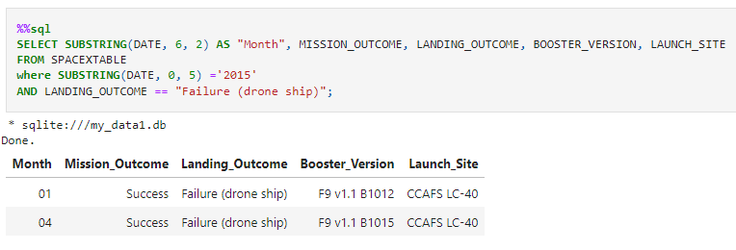
2015 Launch Records
The query consists of the ‘WHERE’ clause, ‘SUBSTRING’, and the ‘AND’ conditions to filter for failed landing outcomes in drop ship, their booster versions, and launch site names for the year 2015.

Slide 33
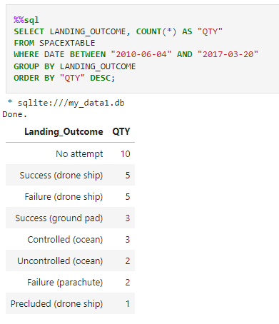
Rank Landing Outcomes Between 2010-06-04 and 2017-03-20
We extracted the details of landing outcomes, applying a filter to include only those occurring between June 4, 2010, and March 20, 2017.
The data was then organized by landing outcomes using the GROUP BY clause, and sorted in descending order with the ORDER BY clause to prioritize the most frequent outcomes.

Slide 34

Section 3

Slide 35
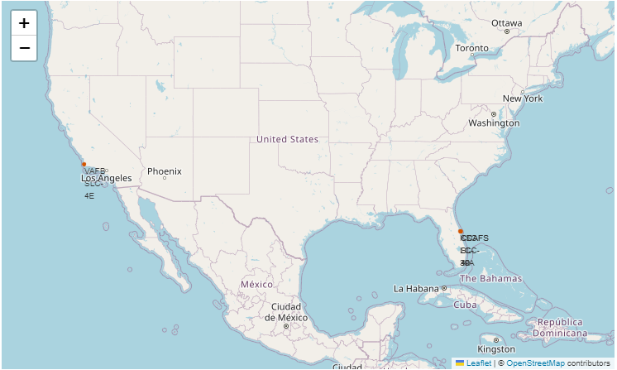
All Launch Sites
The Folium map displays all the launch sites in the United States, they are all along the coastlines of Florida and California.

Slide 36
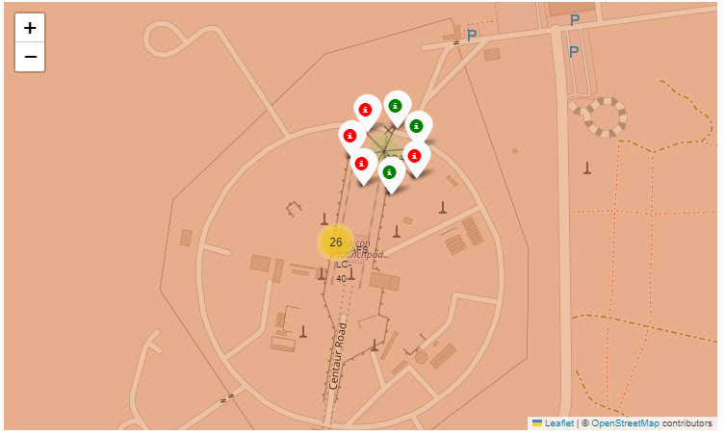
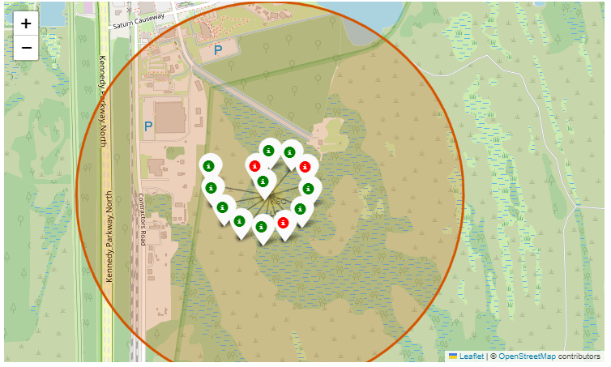
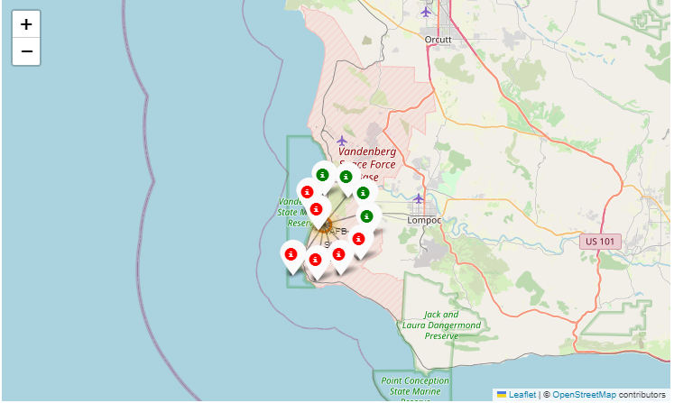
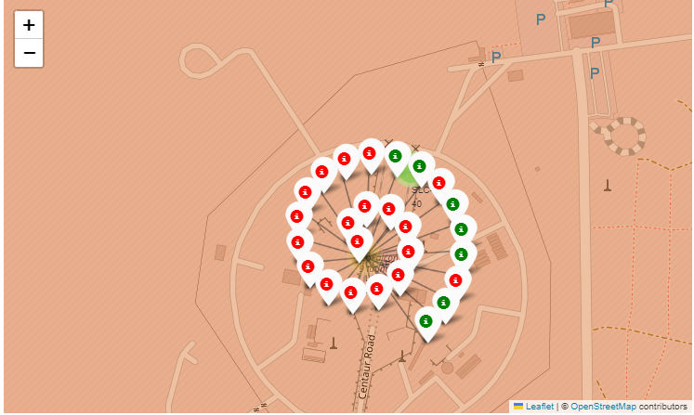
Launch Sites With Color Markers
Florida launch sites:
Green makers for successful launches
Red markers for unsuccessful launches
California launch sites:
Green marker for successful launches.
Red markers for unsuccessful launches.

Slide 37
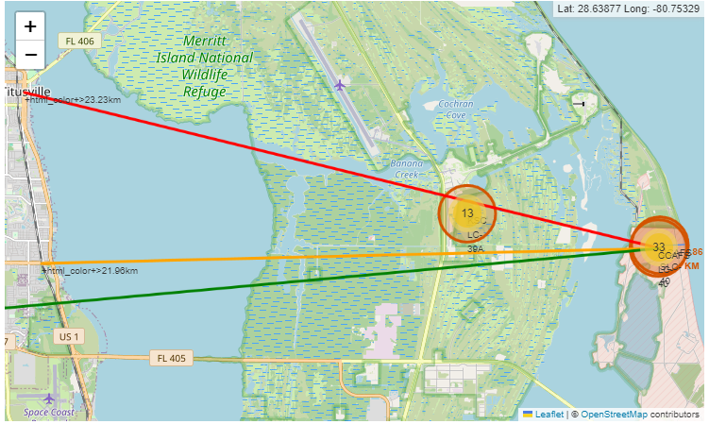
Distance to Proximities
Proximity to railways: 21.96 km
Proximity to highways: 26.88 km
Proximity to coastlines: 0.86 km
Proximity to cities: 23.23 km

Slide 38

Section 4

Slide 39
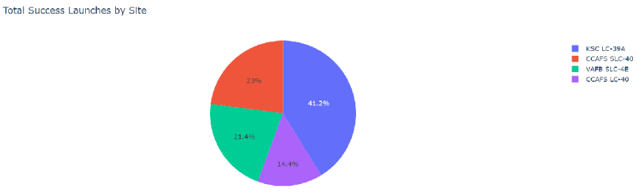
Total Success Launches by Site
The KSC LC -39A launch site had the most successful launches from all sites

Slide 40
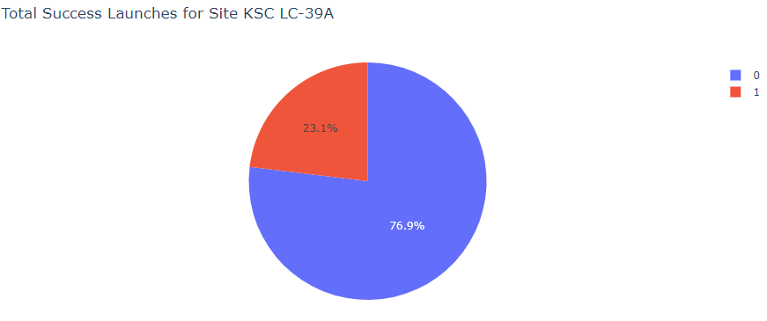
Launch Site With The Highest Launch Success Ratio
KSC LC-39A launch site has the highest success ratio with a success rate of 76.9% and a failure rate of 23.1%

Slide 41
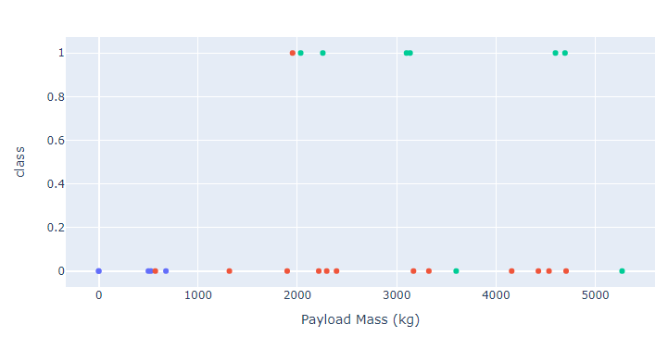
Payload vs Outcome For All Sites
Payloads between 2,000 kg and 5,000 kg have the highest success rate.

Slide 42

Section 5

Slide 43
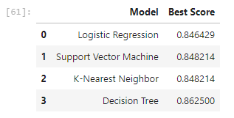
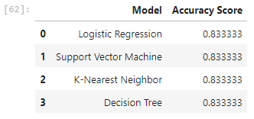
Classification Accuracy
The Decision Tree model performed best with a score of 86%
All models performed similarly on the test set with an 83% accuracy score across the board

Slide 44
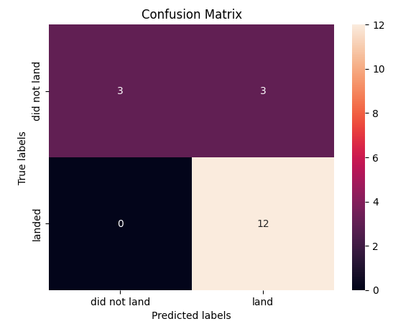
Confusion Matrix
The Confusion Matrix had an output of 3 false positives, which means some unsuccessful landings were classified as successful landings by the classification model (Decision Tree).

Slide 45
Conclusions
The classification models performed similarly on the test set. However, the Decision Tree model performed slightly better with an accuracy score of 86%.
All the launch sites were located near coastlines, far away from urban infrastructure.
On average, the success rate of launches increased over time
The launch site, KSC LC-39A has the highest success rate with a rate of 100% for launches less than 5,000 kg
Orbits ES-L1, GEO, HEO, and SSO have a 100% success rate

Slide 46
Appendix
Include any relevant assets like Python code snippets, SQL queries, charts, Notebook outputs, or data sets that you may have created during this project

Slide 47


